Slide 1
Mission Analytics Platform
MissionSky & MissionPublic Join Development

Slide 2



Analytics Platform
Analytics APIs
JDM Models/PMML

Slide 3
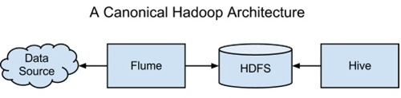

Slide 4
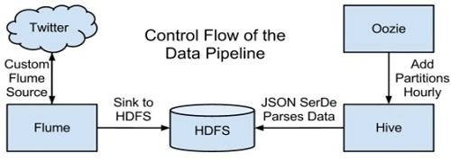

Slide 5
www.cloudera.com
www.cacasding.org

Slide 6
Security and Access Control
Open Standard Integration
Role-based

Slide 7
Application Flow
Restful Web Service Driven
Wizard Templates

